Slide 1
Bayesian Space Time Models, Ice Hockey and You
By Christopher Henson (Data Science - Statistics ‘24)

Slide 2
The Problem (The Importance of Quantifying Player Action)
-Defining hockey analytics challenges.
-Focus on offensive zone possession.

Slide 3
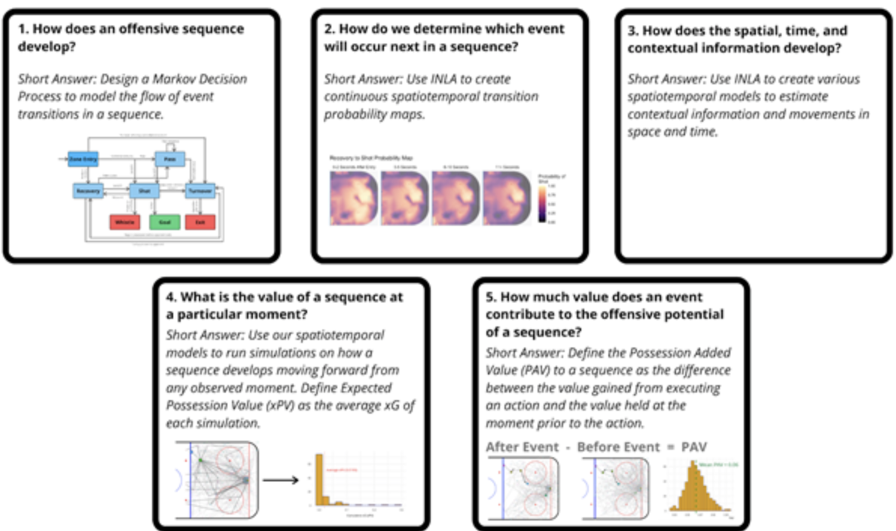
Numerical Examples and Model Application

Slide 4
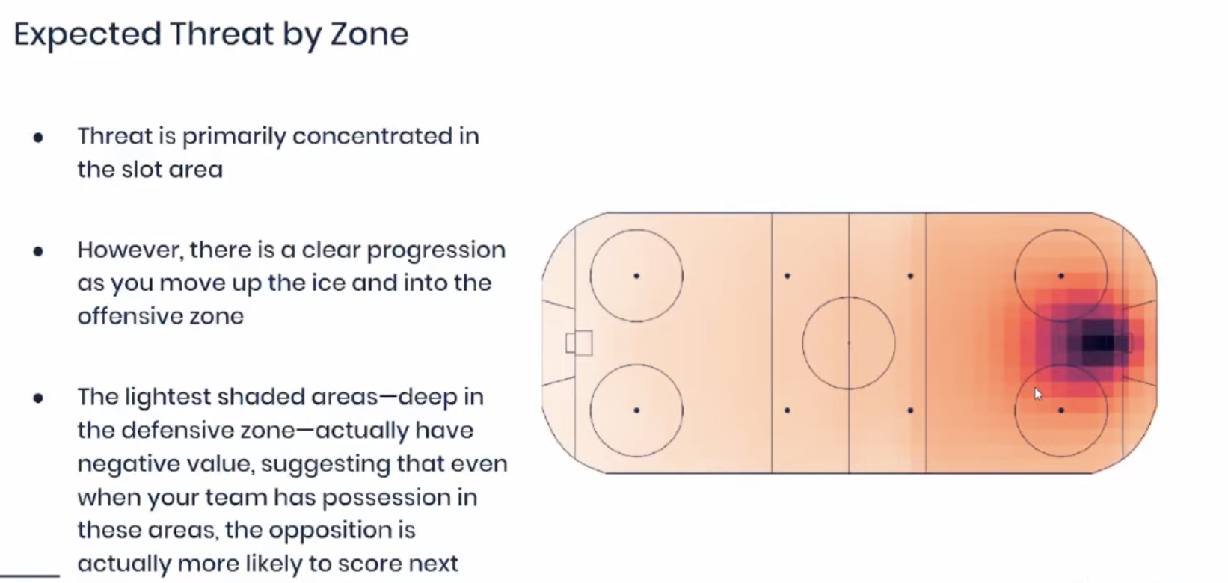
Numerical Examples and Model Application
xT = P(Score) + P(Move, then Score) - P(Turnover, then Opponent Score)

Slide 5
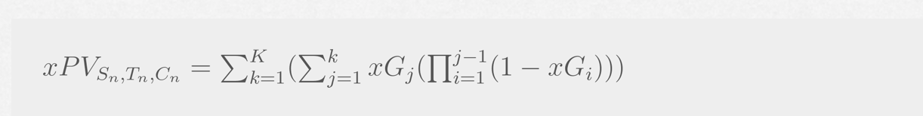
Numerical Examples and Model Application
-Explanation of methodological approach.
-Importance of detailed analysis in hockey.
-Example outcomes of the Bayesian model.

Slide 6
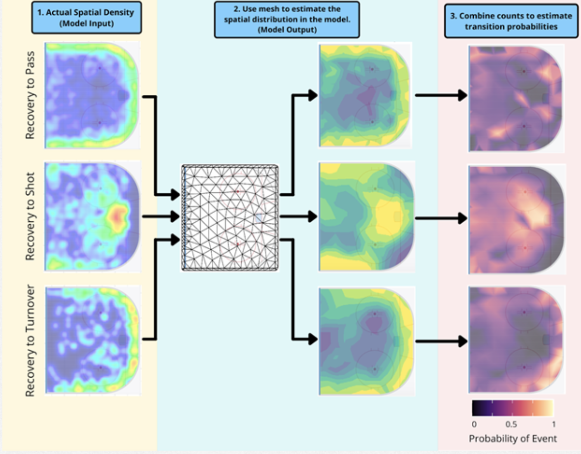
Numerical Examples and Model Application

Slide 7
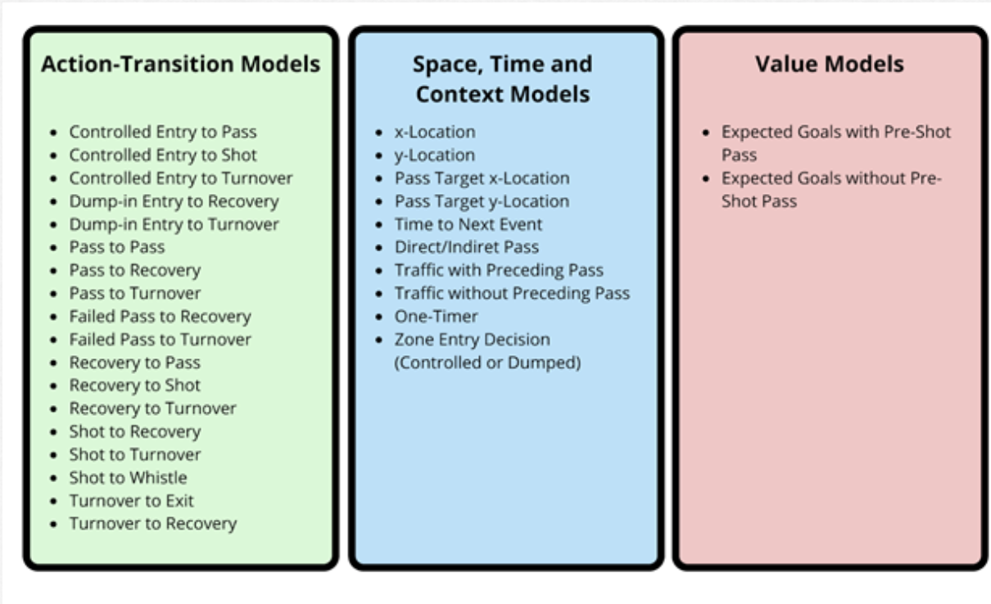
Numerical Examples and Model Application

Slide 8
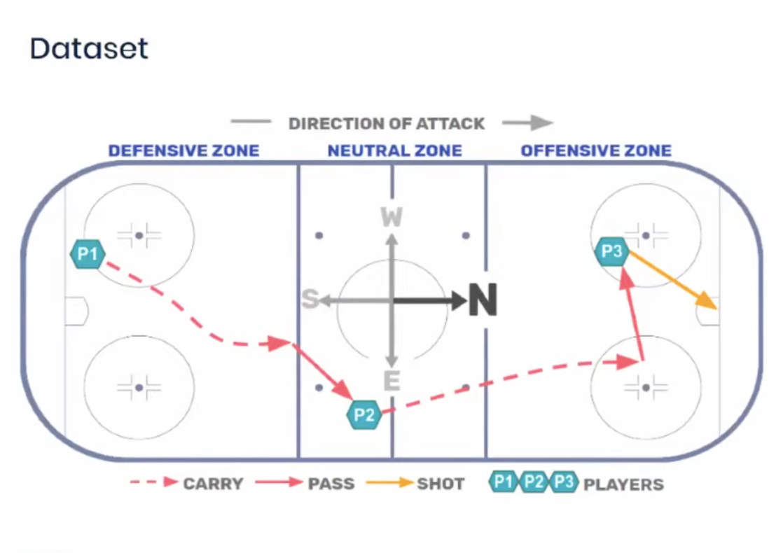

Slide 9
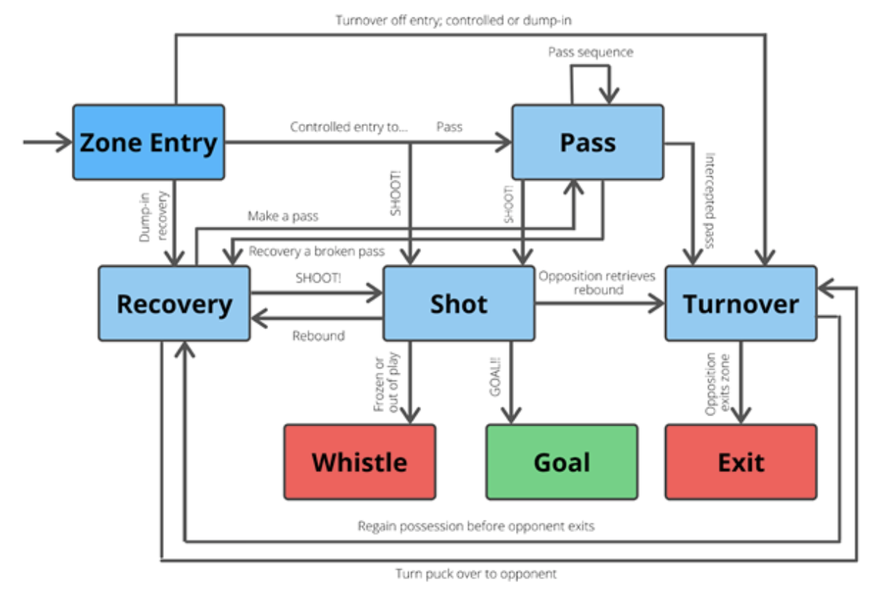
Numerical Examples and Model Application

Slide 10
Strengths and Limitations
-Discuss model's advanced data handling.
-Address computational challenges.
-Balance between complexity and utility.

Slide 11
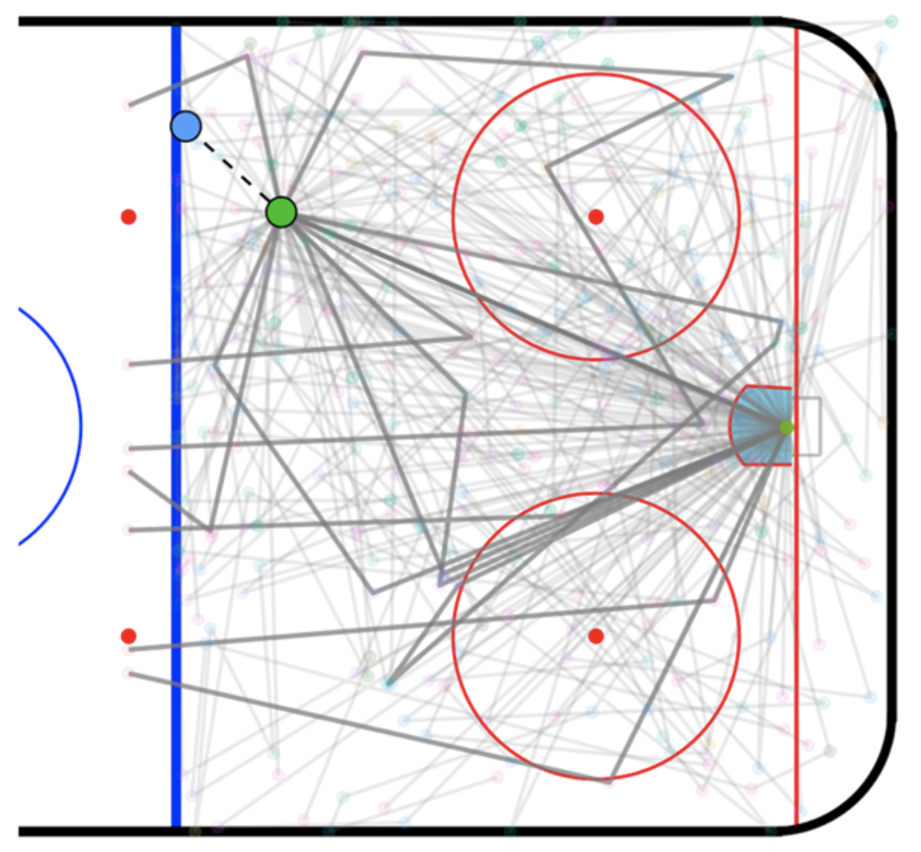
Strengths and Limitations

Slide 12
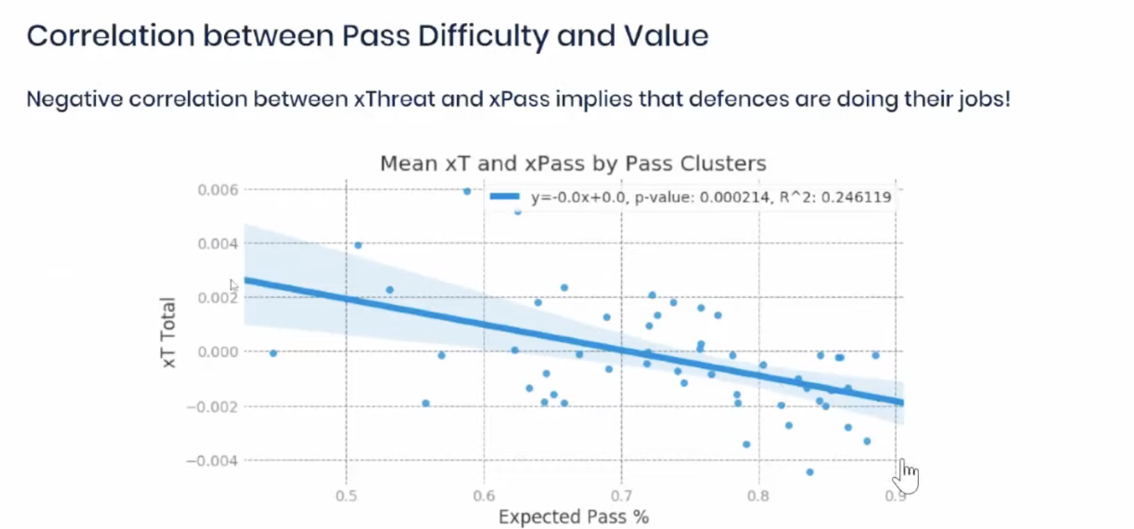
Strengths and Limitations

Slide 13
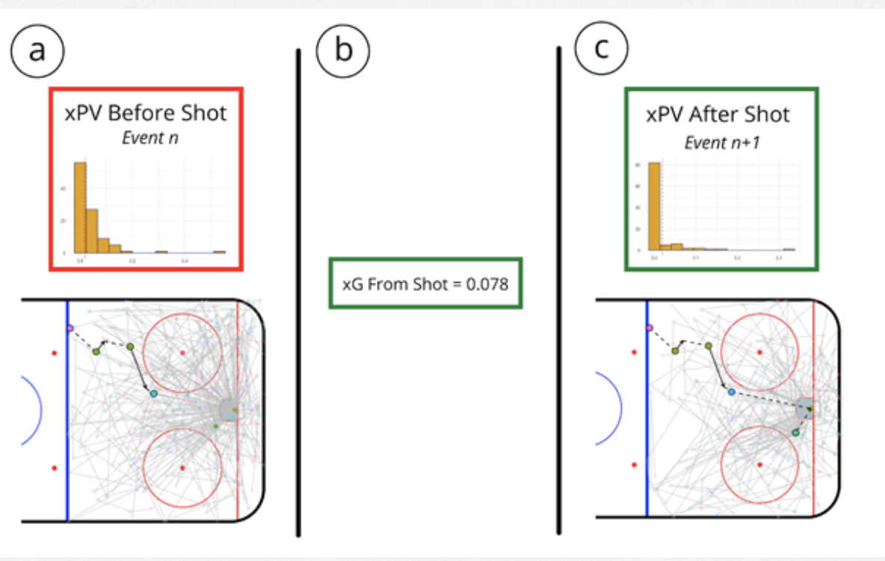
Strengths and Limitations

Slide 14
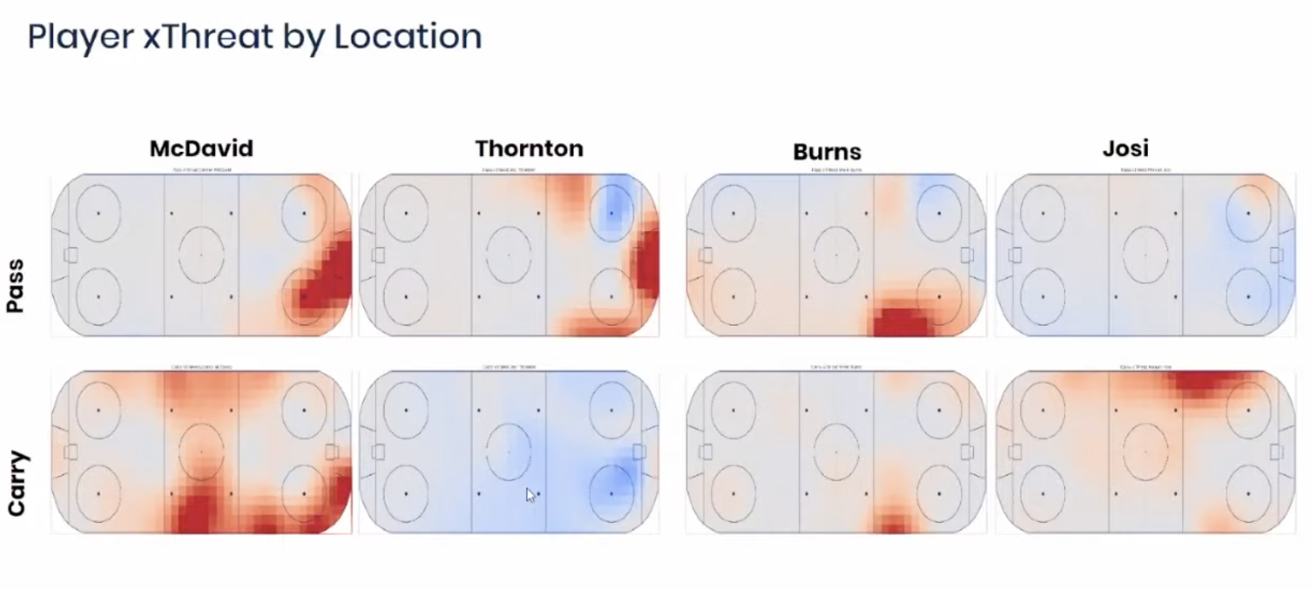
Strengths and Limitations

Slide 15
Recommendations for Improvement
-Suggested improvements in the model.
-Potential applications of PAV in player and team analysis.
-Future directions in hockey analytics.

Slide 16
Conclusion
-Recap of Bayesian Space-Time Models' impact.
-Importance in modern sports analytics.
-Final thoughts on the evolution of hockey analytics.

